Slide 1
First Duty Station
TC
2
OPNAV-FDSFRT-2.0
Catalog ID: OPNAV-FDSFRT-2.0 (Updated April 2023)

Slide 2

Agenda
Basic Finance
Consumer Protections
Major Purchases
Planning for the Future
Compensation, Benefits, and Entitlements
Saving and Investing
First Duty Station Checklist Available

Slide 3
Basic Finance

Slide 4
Military Banking
Types of banking institutions
Things to consider
Typical fees
Credit and debit cards
  Understand correct usage
  Track deposits and expenditures
Account errors
  Review for errors
  Protect your accounts
Military Banking Handout Available

Slide 5
Create a Spending Plan
STEP 1 — Understand your current situation
  Track inflows and outflows
  Review past financial statements
STEP 2 — Know where your money should go
  Save and/or invest 10% – 15%*
  Transportation less than 15% – 20%*
  Limit housing to BAH or 25% or less*
STEP 3 — Create a plan
  Prioritize financial goals
  Automate saving and bill paying
  Build an emergency fund
STEP 4 — Make adjustments
  Update with life changes
  Review frequently
STEP 1:
Understand your current
situation
STEP 4:
Make
adjustments
STEP 2:
Know where
your money
should go
  * Pretax income
4-STEP BUDGETING
PROCESS
STEP 3:
Create a plan
Spending Plan Worksheet Handout and Checklist Available

Slide 6
Review Your Tax Situation
Use IRS withholding estimator at https://www.irs.gov
Make changes in https://mypay.dfas.mil/
  The Navy Personnel and Pay (NP2) system is currently scheduled to replace myPay for payroll functions in 2024.
Military Spouse Residency Relief Act (MSRRA)
Seek help from Military OneSource for free software and professional assistance

Slide 7
Income Tax Fundamentals
Types of income taxes
  Federal
  FICA
  State
  Listed on your LES
Tax benefits for Service members
  BAH / BAS not taxed
  Potential savings related to TSP
  Assistance available through Military OneSource MilTax Resource Center and VITA
Potential changes
  Review and adjust withholding if needed
  Filing status accuracy

Slide 8
Consumer Protections
First Duty Station Checklist Available

Slide 9
Identity Theft
Secure your information
  Follow PII regulations and procedures
  Safeguard your wallet
  Sign up for electronic statements
  Opt out and do not call
  Periodically review credit report
  Update computer security settings
  Avoid unsecure WiFi networks
  Active-duty alert
  Credit freeze
Report a complaint
Military Consumer Protection Handout Available

Slide 10
Servicemembers Civil Relief
Act (SCRA)
Contracts for debts prior to qualifying military orders
  Loan rate capped at 6%
  Terminate residential or auto lease
  Cancel cellphone service contract
Stay civil judgments
  Eviction and foreclosure
  Default judgment
  Property repossession or seizure
Insurance
  Life insurance premium payments
  Health insurance reinstatement
State income tax statutes
Military Consumer Protection Handout Available

Slide 11
Military Lending Act (MLA)
Protection from predatory lending
Protects active duty, active Guard / reserves, dependents
Interest rate capped at 36% on most consumer loans
  Peer-to-peer loans not covered
  Loans made outside U.S. not covered
Military Consumer Protection Handout Available

Slide 12
Misleading Consumer Practices
Recognize scams
  Multilevel marketing / pyramid scheme
  Get rich quick
  Too good to be true
Protect yourself
  Needs, wants, wishes
  Research
  Comparison shop
  Sleep on it
Report a complaint
Sources of Help for Military Consumers Handout Available

Slide 13
Protect Your Credit Reputation
Create healthy habits
  Establish banking and credit system
  Pay bills on time
  Pay off credit cards monthly
  Reconcile statements
  Safeguard information
Understanding credit
  Credit reports
  Credit scores
  Only apply if you
  need credit
Review credit report
  https://www.annualcreditreport.com/
  Take advantage of free credit monitoring
Types of
Credit
10%
New
Credit
10%
Length of
Credit History
15%
Payment
History
35%
Amounts
Owed
30%
Understanding Credit Handout Available

Slide 14
Major Purchases
First Duty Station Checklist Available

Slide 15
Major Purchases
Think first
  Logic over emotion
  Understand additional costs
  Consider potential life changes
  Shop around
  Cash or credit
Avoid trouble
  Needs, wants, wishes
  Wait
  Seek helpful guidance
Major Purchases and 5 Rules of Buying a House Handout Available

Slide 16
Financing a Major Purchase
Plan ahead
Know your needs and budget
Educate yourself and be prepared financially
Seek assistance from the Fleet and Family Support Center (FFSC)
  Attend a Car Buying or Home-Buying class
  Schedule an individual appointment

Slide 17
Car-Buying Basics
Loan Amount
Total Interest Paid
Interest Rate
Length
Payments
6%
APR
3
Years
+
$16,428
$456 x 36 $15,000 $1,428
4
Years
+
$16,909
$352 x 48 $15,000 $1,909
5
Years
+
$290 x 60 $15,000 $2,400
$17,400
Loan Amount
Total Interest Paid
Interest Rate
Length
Payments
10%
APR
3
Years
+
$17,424
$484 x 36 $15,000 $2,424
4
Years
+
$18,261
$380 x 48 $15,000 $3,261
5
Years
+
$319 x 60 $15,000 $4,122
$19,122
Three deals of car buying
1. Total purchase price 2. Financing 3. Trade-In
Major Purchases Handout Available

Slide 18
Education Benefits
Tuition Assistance (TA)
College Level Examination Program (CLEP)
Paying back student loans
  SCRA to reduce APR to 6%
  College Loan Repayment Program (CLRP)
  Public Service Loan Forgiveness Program (PSLF)
  0% Interest during deployments
  Repayment options
GI Bills
Education Savings and Benefits and Paying off Student Loans Handouts Available

Slide 19
Planning for the Future
First Duty Station Checklist Available

Slide 20
LIFE Insurance Needs
Liabilities (debts and obligations)
Income (amount X number of years needed) | +
Final expenses | +
Education and other goals | +
–
Subtract current coverage and assets
Your Total Need
First Duty Station Checklist Available

Slide 21
Life Insurance
Servicemembers’ Group Life
Insurance (SGLI)
  Coverage
  Beneficiaries
Family Servicemembers’ Group Life Insurance (FSGLI)
Private life insurance
  Term and permanent coverage
  War clause and other restrictions
  Beneficiaries
  Premium payments
First Duty Station Checklist Available

Slide 22
Property and Auto
Renters insurance
    Protection for your belongings
    Inexpensive
Auto insurance
    State requirements
    Loan requirements
    Liability versus full coverage
First Duty Station Checklist Available

Slide 23
Compensation, Benefits,
and Entitlements
First Duty Station Checklist Available

Slide 24
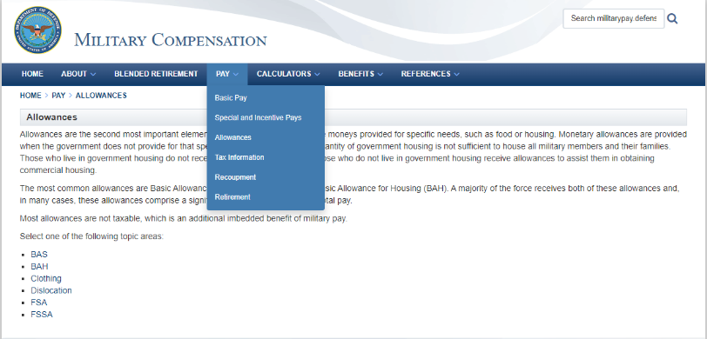
Compensation
Basic Pay • Special and Incentive Pays • Allowances
http://www.militarypay.defense.gov
First Duty Station Checklist Available

Slide 25
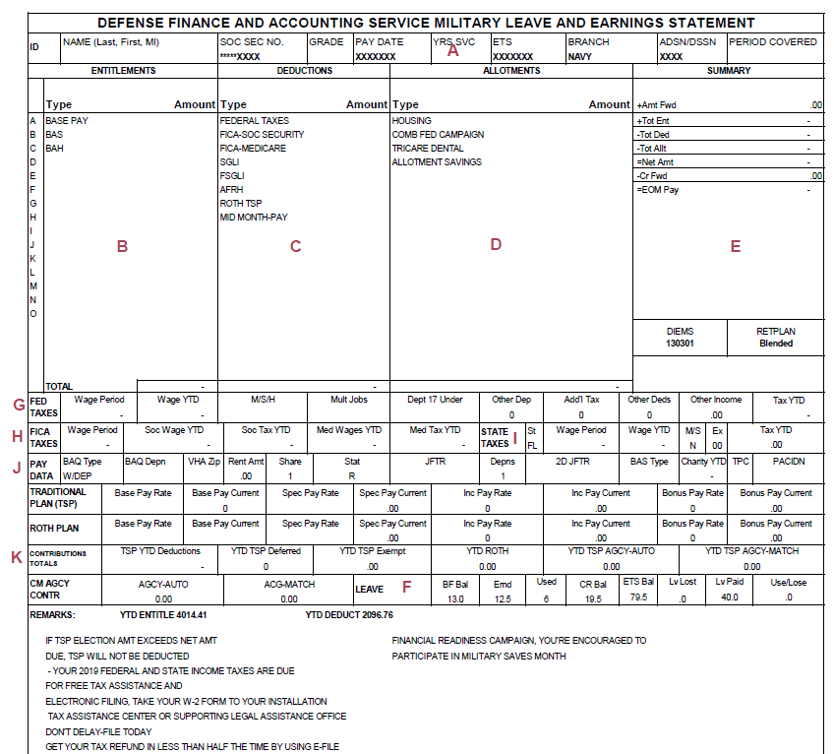
Leave and Earnings Statement (LES)
  Entitlements (B)
  Deductions (C)
  Taxes (G/H/I)
  Pay Data (J)
  (BAH & VHA)
  TSP (K)
  Remarks (L)
L

Slide 26
TRICARE Basics
TRICARE
  Become familiar with benefits
  Defense Enrollment Eligibility Reporting System (DEERS)
  Coordinate other health insurance benefits
  Visit https://tricare.mil
TRICARE Dental
  Enroll family members
  Visit https://tricare.mil/Dental
TRICARE Overview Handout Available

Slide 27
Career Investment Options
United States Military Apprenticeship Program (USMAP)
Credentialing Opportunities On-Line Program (COOL)
https://dodcareerready.usalearning.gov/service_members
Education Savings and Benefits Handouts Available

Slide 28
Saving and Investing
First Duty Station Checklist Available

Slide 29
Saving vs. Investing
Saving
  Safe, low-risk (return of your money)
  Low interest
  Short-term goals (emergency funds, vacation, etc.)
Investing
  Takes risk (return on your money)
  Potential for higher returns
  Long-term goals (major purchase, retirement, etc.)
Basic Investing Handout Available

Slide 30
Compound Interest
$ 1M
$ 800k
$ 600k
$ 400k
$ 200k
$ 0k
$1,054,907.88
Estimated Totals with 8% Rate of Return and Retirement Age of 65
$698,201.57
Pressy saves $200/mo.
Starting at age 20
Mandi saves
$200/mo.
Starting at age 25
$298,072.00
Steve saves
$200/mo.
Starting at age 35
20
25
35
65
PRESSY
MANDI
STEVE
Basic Investing Handout Available

Slide 31
Types of Investments
Lower risk
Lower return
Shorter timeframe
higher risk
Potentially higher return
Longer timeframe
CASH
Security
Examples:
Certificates of Deposit
Money Market Account
Savings Account
BONDS
Lending
Examples:
U.S. Government
U.S. Corporate
Municipal
Foreign Government / Corporations
STOCKS
Ownership
Examples:
Small / Med / Large Co. Stocks
U.S. / Foreign Stocks
Oil / Gold
REITs
This is simply an illustration of the general relationship between various asset classes. Some investments will not align with this model.
Basic Investing Handout Available

Slide 32
Understanding Your TSP
Taxes deferred
Taxes paid up front
Taxable when withdrawn
Tax-free earnings when withdrawn
Traditional
Roth
Thrift Savings Plan Handout Available

Slide 33

TSP Investment Choices:
Individual Funds
G FUND
Government Securities Investment Fund
What It Is: Government securities that are specially issued to the TSP
Pros: Does not lose money; has a consistent but relatively low investment return
Risks: Your money may
not grow to meet your retirement needs or outpace inflation.
F FUND
Fixed Income Index Investment Fund
What It Is: Government, corporate, and asset-backed bonds
Pros: May earn returns that are higher than money market funds over the long term with relatively low risk
Risks: Bond prices fall when interest rates rise. Bonds may be repaid early, reducing your returns.
Benchmark Index: Bloomberg Barclays
U.S. Aggregate Bond Index
C FUND
Common Stock Index Investment Fund
What It Is: Stocks of large and medium-sized U.S. companies
Pros: Potential for high investment returns over the long term
Risks: Can be volatile depending on stock market performance
Benchmark Index: Standard & Poor’s
500 Stock Index
S FUND
Small Capitalization Stock Index Investment Fund
What It Is: Stock of small to medium-sized U.S. companies
Pros: Potential for high investment returns over the long term
Risks: Can be volatile depending on stock market performance
Benchmark Index: Dow Jones U.S. Completion TSM Index
I FUND
International Stock Index Investment Fund
What It Is: International stocks from more than 20 developed countries
Pros: Potential for high investment returns over the long term
Risks: Can be volatile depending on stock market performance
Benchmark Index:
MSCI EAFE Stock Index
For more comprehensive information, visit https://www.tsp.gov and select “Learn about fund options” from the menu

Slide 34

TSP Investment Choices:
Lifecycle Funds
Each L Fund is a mix of individual funds based on when you’ll need your money
L 2065
L 2060
L 2055
L 2050
L 2045
  Consider if you were born after 1999 or plan to withdraw from your account after 2062.
  For the
  long-term investor
  Consider if you were born between
  1995-1999 or plan to withdraw from your account between
  2058-2062.
  For the
  long-term investor
  Consider if you were born between
  1990-1994 or plan to withdraw from your account between
  2053-2057.
  For the
  long-term investor
  Consider if you were born between
  1985-1989 or plan to withdraw from your account between
  2048-2052.
  For the
  long-term investor
  Consider if you were born between
  1980-1984 or plan to withdraw from your account between
  2043-2047.
  For the
  long-term investor
L 2040
L 2035
L 2030
L 2025
L INCOME
  Consider if you were born between
  1975-1979 or plan to withdraw from your account between
  2038-2042.
  For the
  long-term investor
  Consider if you were born between
  1970-1974 or plan to withdraw from your account between
  2033-2037.
  For the
  medium-term investor
  Consider if you were born between
  1965-1969 or plan to withdraw from your account between
  2028-2032.
  For the
  medium-term investor
  Consider if you were born between
  1958-1964 or plan to withdraw from your account between
  next year and 2027.
  For the
  short-term investor
  Consider if you were born between
  1958 or already withdrawing from your account.
  For those
  already withdrawing
With the exception of L Income, the investment mix of each L Fund becomes more conservative over time. To change your investments, log in to My Account on https://www.tsp.gov and choose “Contribution Allocation” or “Interfund transfers” from the the menu.
Thrift Savings Plan Handout Available

Slide 35
New TSP Experience
Digital tools
  Mobile app
  Virtual assistant
  Live agent chat
Streamlined processes
  Electronic signature
  Rollover assistance
  Electronic payment options
  Secure participant mailbox
Mutual Fund Window
  Greater investment flexibility
  Eligibility requirements
  Additional fees

Slide 36
Blended Retirement System:
Automatic and Matching Contributions
Defined Contribution Thrift Savings Plan (TSP)
You Contribute | DoD Automatic Contribution (Traditional) | DoD Matching Contribution (Traditional) | Total
0% | 1% | 0% | 1%
1% | 1% | 1% | 3%
2% | 1% | 2% | 5%
3% | 1% | 3% | 7%
4% | 1% | 3.5% | 8.5%
5% | 1% | 4% | 10%
• 1% DoD Automatic Contribution begins 60 days after entering service.
• 4% DoD Matching Contributions begin after completing two years of service.
• Both automatic and matching contributions are vested after serving two years.

Slide 37
Manage Your TSP
https://mypay.dfas.mil/
  Start – stop – change
    Percentage
    Type (Traditional / Roth)
  Update address
TSP.gov or TSP mobile app
  View portfolio
  Manage investments
  Change allocations
  Review and update beneficiaries

Slide 38
Summary
Congratulations on your First Duty Station assignment!
Let’s recap what you learned about:
  Basic Finance
  Consumer Protections
  Major Purchases
  Planning for the Future
  Compensation, Benefits, and Entitlements
  Saving and Investing

Slide 39


Resources
Checklist and Handouts
Financial Education and Support
  Command Financial Specialists (CFSs)
  Personal Financial Managers (PFMs)
  Fleet and Family Support Center (FFSC)
  Navy-Marine Corps Relief Society (NMCRS)
  Military OneSource
Financial Literacy Mobile Apps
  MyNavy Financial Literacy
  Sen$e

Slide 40
Thank You!
The appearance of U.S. Department of Defense (DoD) visual information does not imply or constitute DoD endorsement.
Catalog ID: OPNAV-FDSFRT-2.0 (Updated April 2023)

